Slide 1
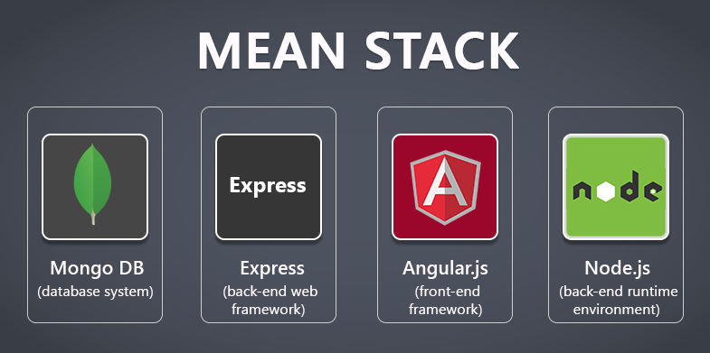
MOVIE BOOKING WEBSITE PROJECT BY MEANSTACK

Slide 2
LIST OF PAGES
HOME PAGE
BOOKING PAGE
SEAT SELECTING PAGE
CONFIRMATION PAGE
LOGIN PAGE
REGISTRATION PAGE
ADMIN PAGE
MOVIEMAPPING PAGE

Slide 3
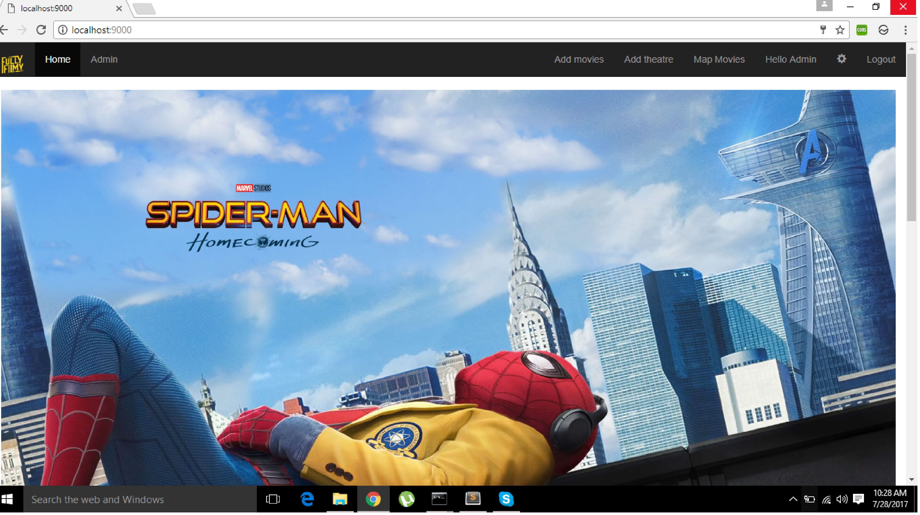
HOME PAGE

Slide 4
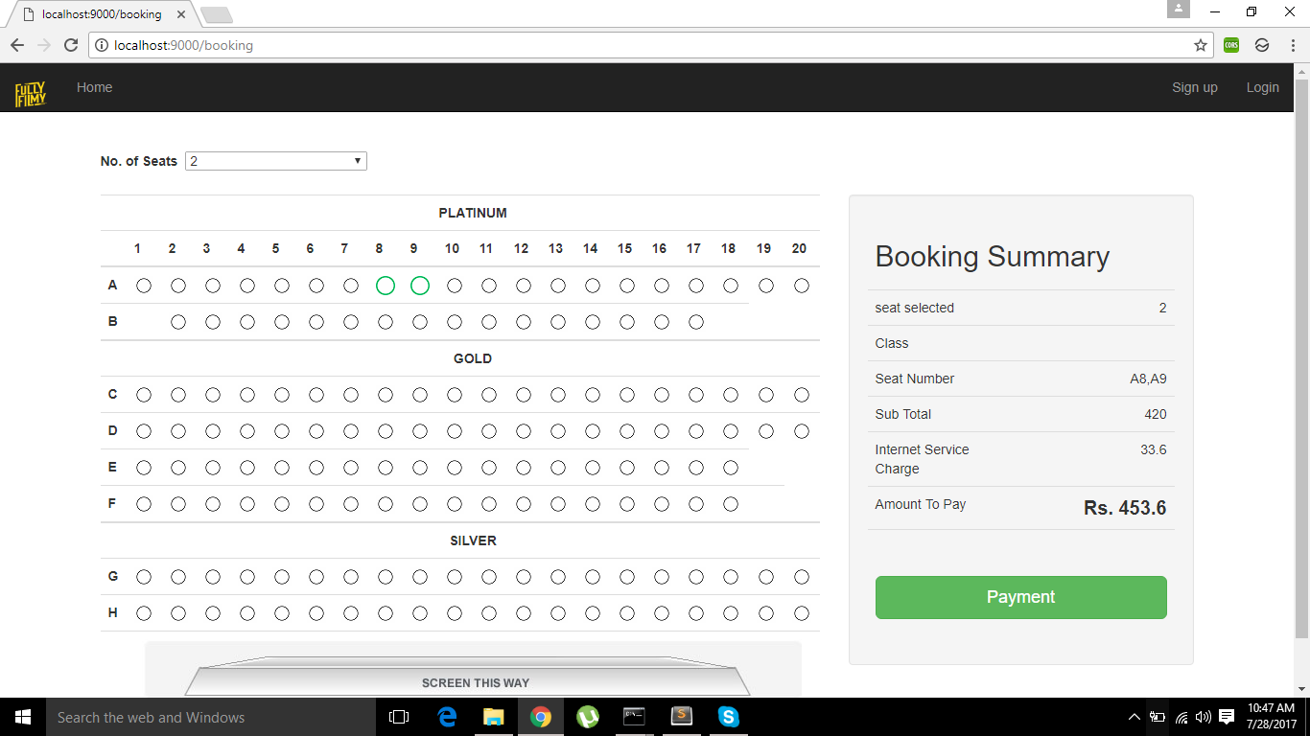
BOOKING PAGE

Slide 5
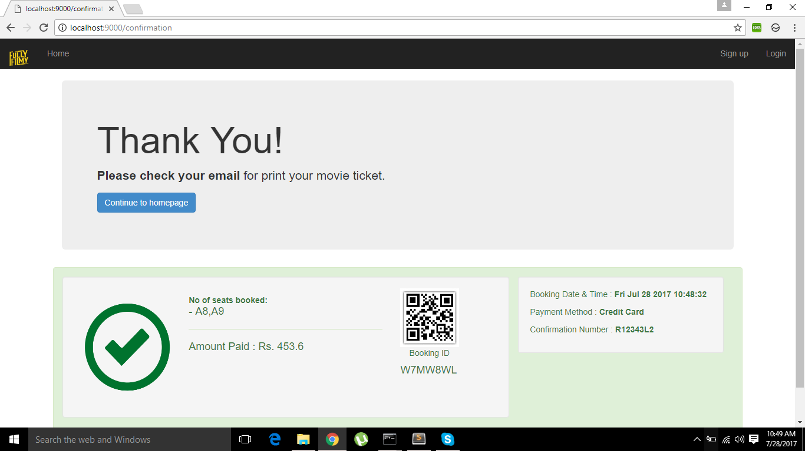
CONFIRMATION PAGE

Slide 6
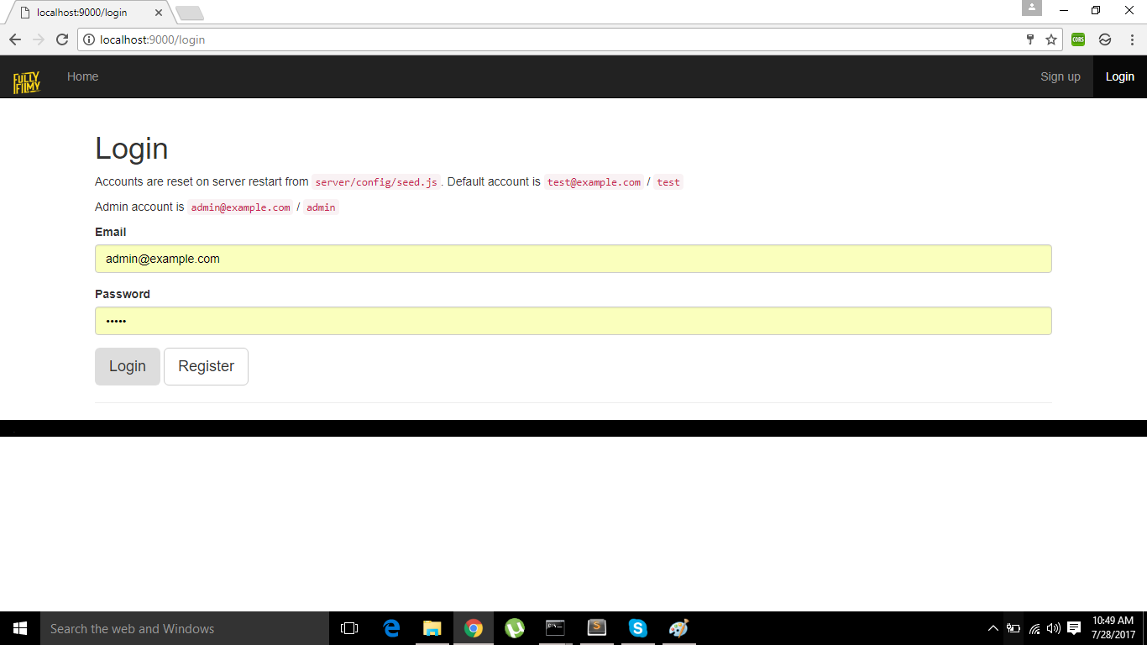
LOGIN PAGE

Slide 7
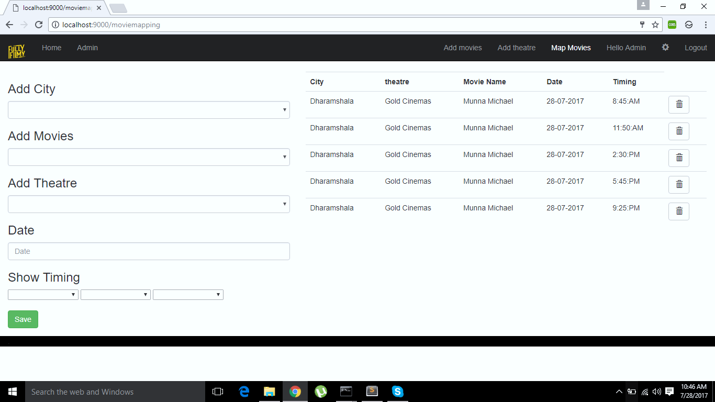
MOVIE MAPPING PAGE

Slide 8
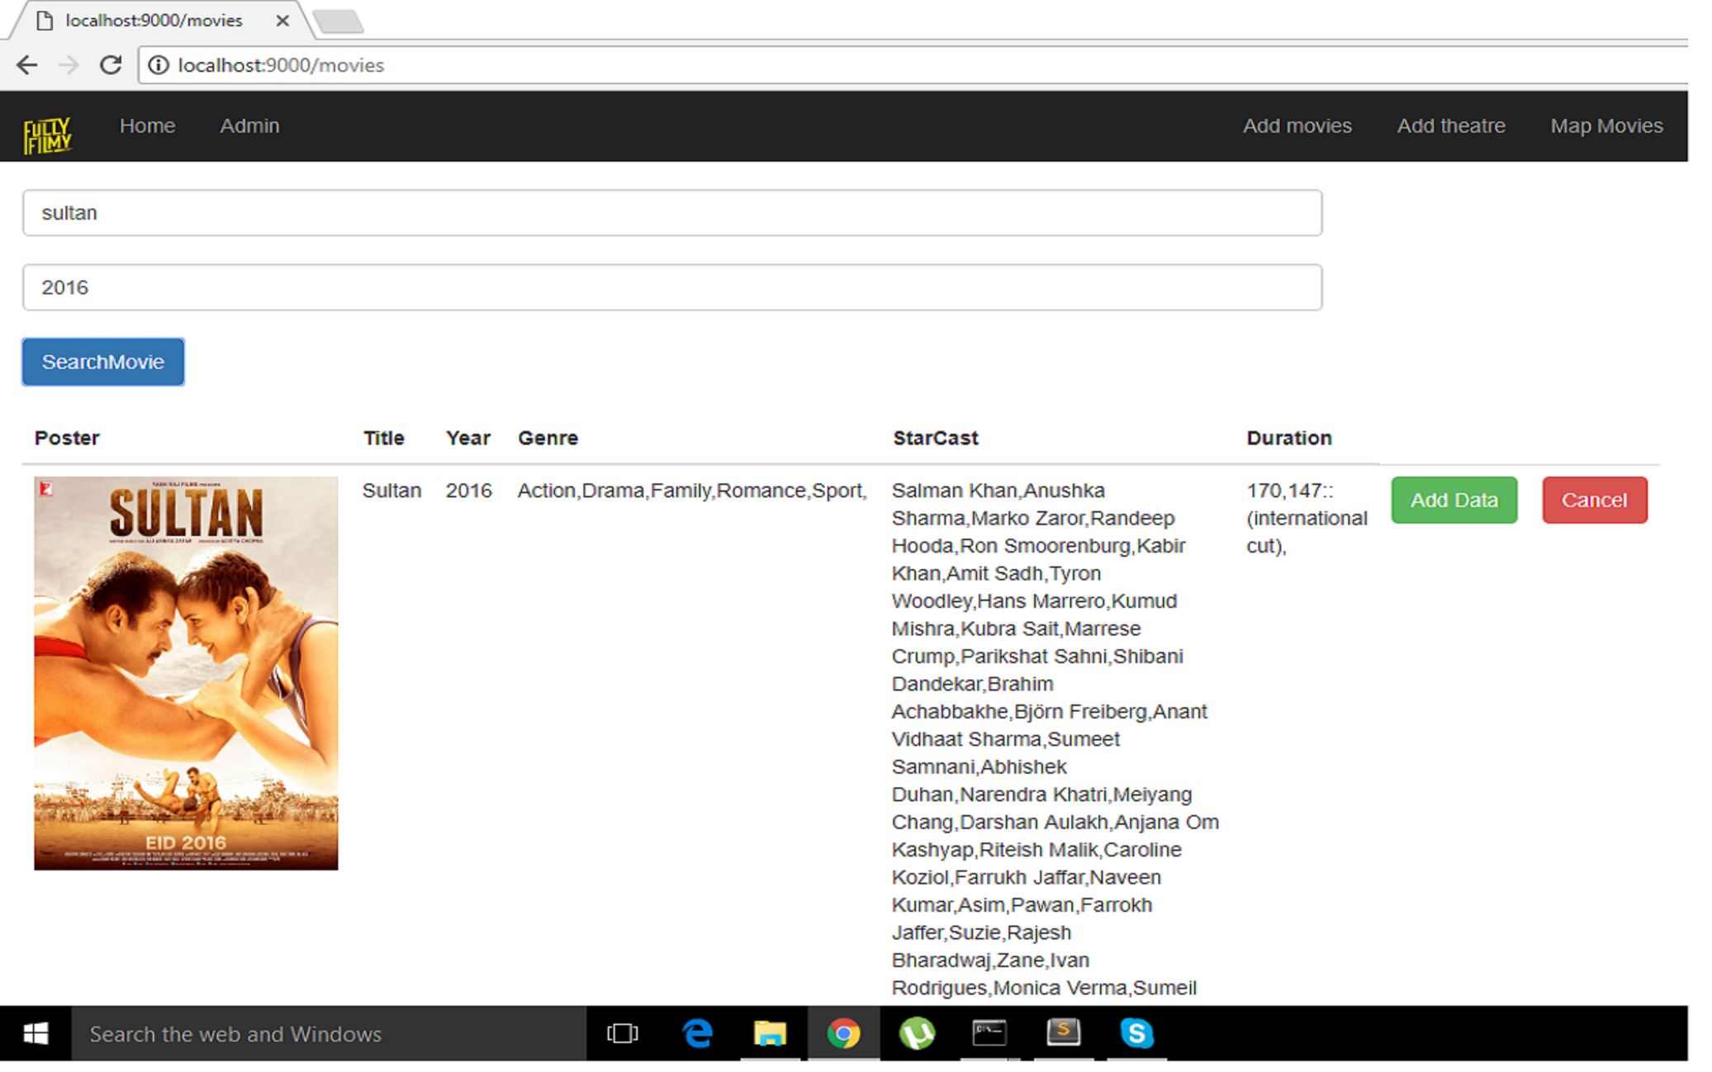
ADD MOVIE PAGE

Slide 9
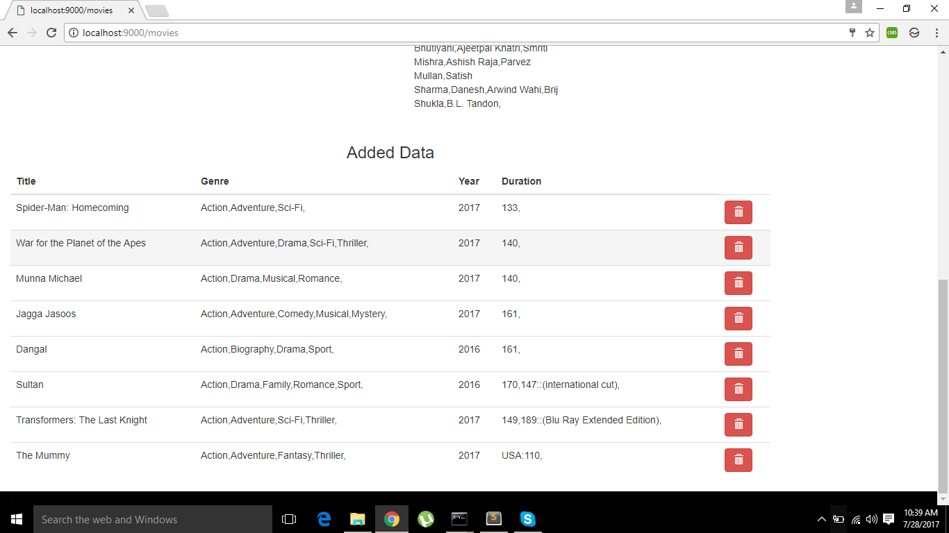
ADD MOVIE PAGE

Slide 10
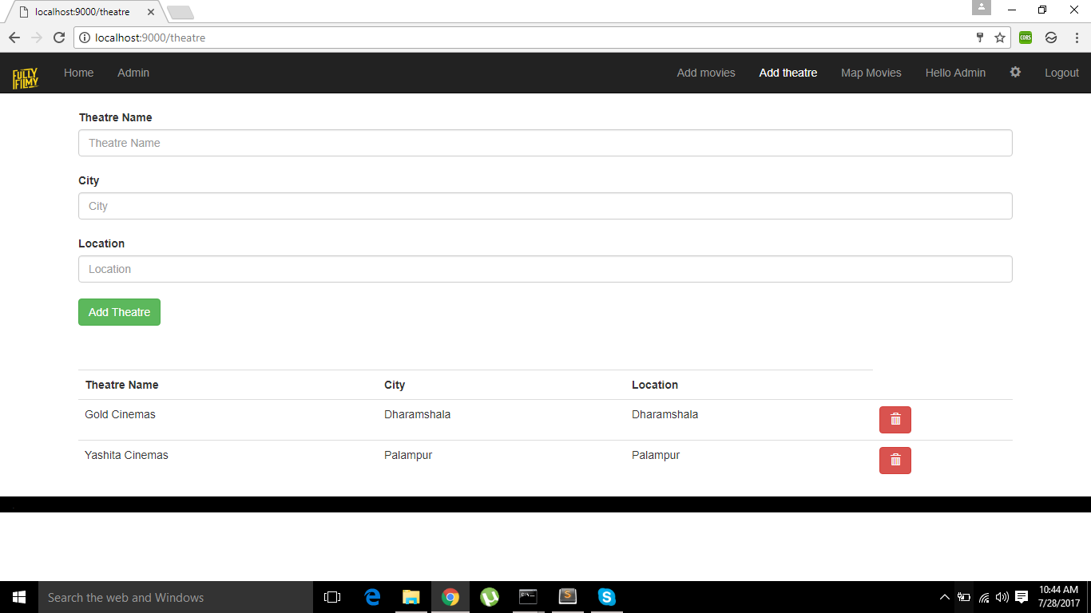
THEATRE PAGE

Slide 11


